Slide 1
Neuromancer: Differentiable Programming Library for Modeling, Control, and Optimization
CDC Workshop on Benchmarking, Reproducibility, and Open-Source Code in Controls
Ján Drgoňa, Aaron Tuor, James Koch, Madelyn Shapiro, Rahul Birmiwal, Draguna Vrabie

Slide 2
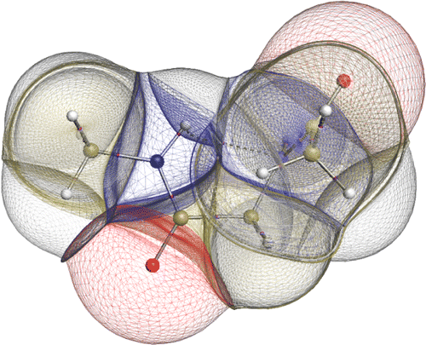

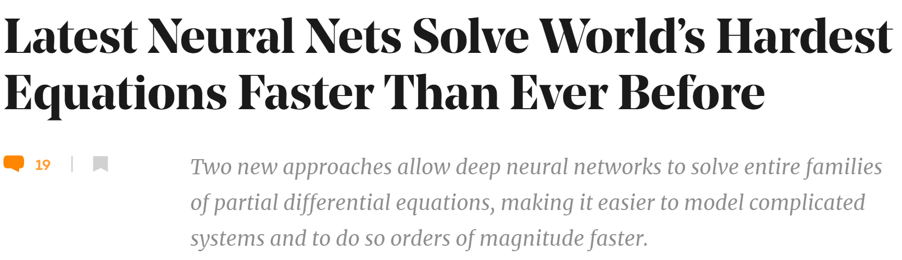

Challenges of Dynamical Systems Modeling and Control
Simulations are crucial for many areas of decision-making and scientific discovery
Need: Improve computational efficiency and scalability for heterogenous scientific simulations
Challenges:
Physically-consistent data-driven modeling
Fast simulation of complex systems
Optimal control and design of complex systems
Emerging solution:
Scientific Machine Learning connecting physics and AI domains

Slide 3

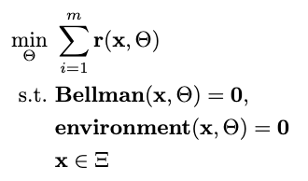

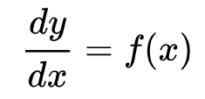

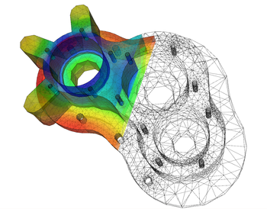
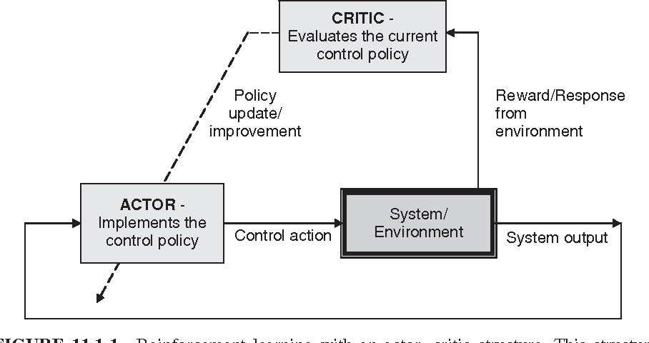

Landscape of Solution Methods
Constrained optimization
Differential equations
Supervised Learning
Reinforcement Learning
Requires prior knowledge of objective function and constraints
Requires prior knowledge of the physics to be modeled
Requires large labeled datasets
Requires environment model to sample
More domain knowledge
Less domain knowledge

Slide 4




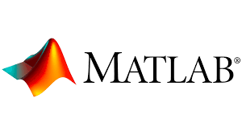
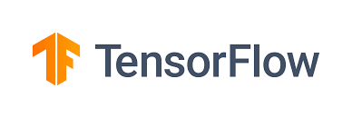



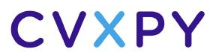

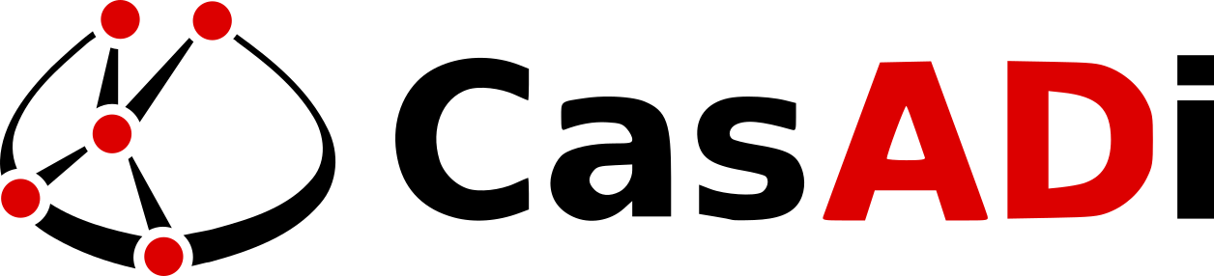
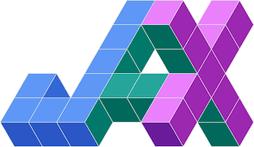



Landscape of Solution Tools
Constrained optimization
Differential Equations
Supervised Learning
Reinforcement Learning
More domain knowledge
Less domain knowledge

Slide 5
Landscape of Solution Tools
Online optimization
Differential Equations
Supervised Learning
Reinforcement Learning
What comes next? … Differentiable programming (DP): a unifying approach for data-driven modeling and optimization of complex systems based on automatic differentiation (AD)

Slide 6
Differentiable Programming Enables Scientific Machine Learning
Differentiable Programming
M. Innes, et al., A Differentiable Programming System to Bridge Machine Learning and Scientific Computing, 2019
Physics-informed Neural Networks
M. Raissi, et al., Physics-informed neural networks: A deep learning framework for solving forward and inverse problems involving nonlinear partial differential equations, 2019
Neural Differential Equations
R. T. Q. Chen, et al., Neural Ordinary Differential Equations, 2019
C. Rackauckas , et al., Universal Differential Equations for Scientific Machine Learning, 2021
Differentiable Optimization
A. Agrawal, et al., Differentiable Convex Optimization Layers, 2019
P. Donti, et al., DC3: A learning method for optimization with hard constraints, 2021
S. Gould, et al., Deep Declarative Networks: A New Hope, 2020
J. Kotary, et al., End-to-End Constrained Optimization Learning: A Survey, 2021
Differentiable Control
B. Amos, et al., Differentiable MPC for End-to-end Planning and Control, 2019
S. East, et al., Infinite-Horizon Differentiable Model Predictive Control, 2020

Slide 7
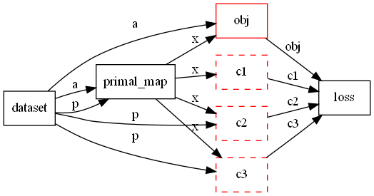
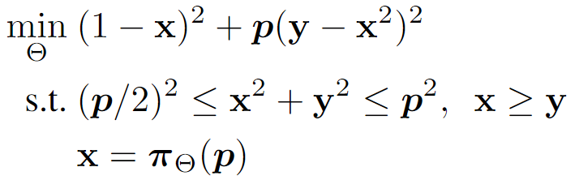
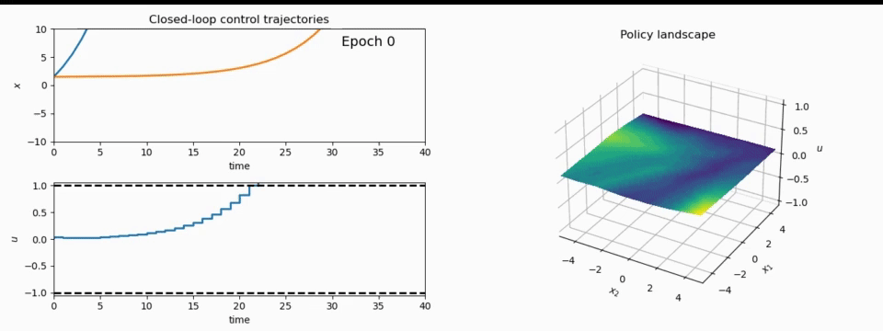
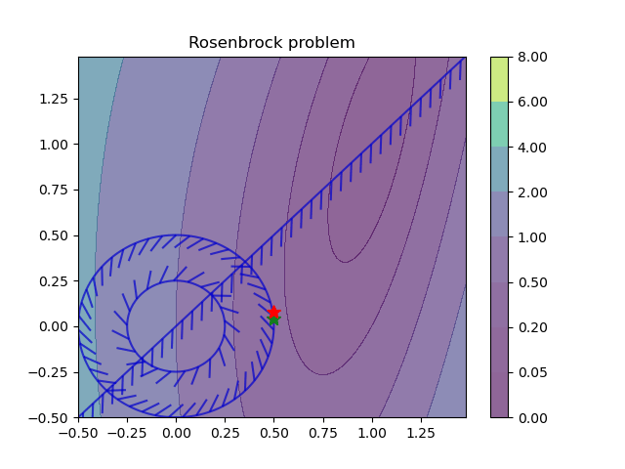
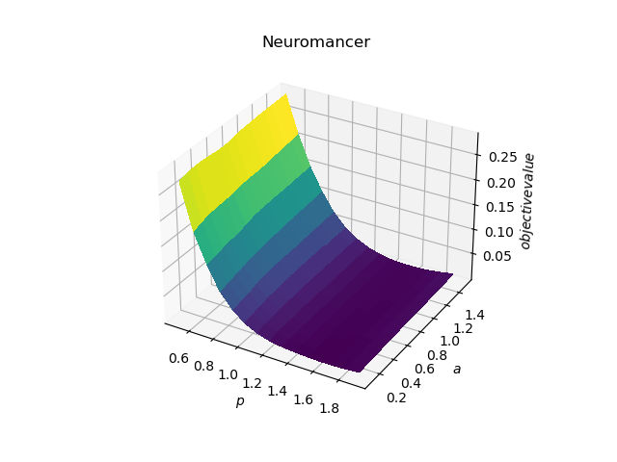
NeuroMANCER: a Scientific Machine Learning Library
1. Mathematical formulation
3. Problem graph
map
2. Python code interface
4. Results
import neuromancer as nm
p = nm.variable(‘p’)
x = nm.variable(‘x’)
y = nm.variable('y’)
obj = ((1-x)**2 + p*(y-x**2)**2).minimize() c1 = (p/2)**2 <= x**2 + y**2
c2 = x**2 + y**2 <= p**2
c3 = x >= y net = nm.MLP(insize=2, outsize=2, hsizes=[80]*4) map = nm.Node(net, input_keys=['p’], output_keys=[‘x’,‘y’])
loss = nm.PenaltyLoss([obj], [c1, c2, c3]) problem = nm.Problem([map], loss)
optimizer = torch.optim.AdamW(problem.parameters()) trainer = nm.Trainer(problem,data,optimizer)
best_model = trainer.train()

Slide 8
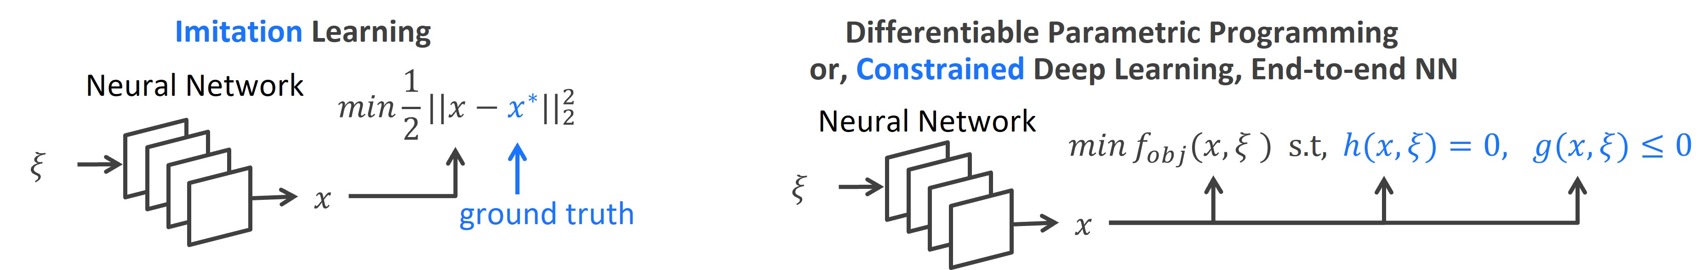
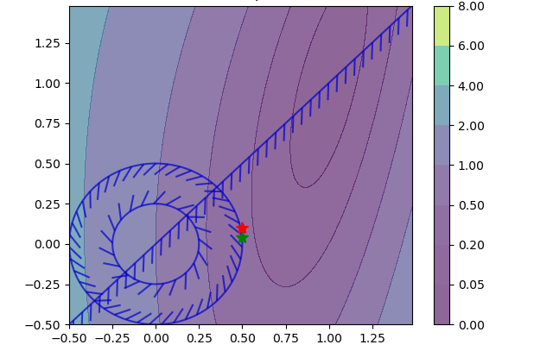
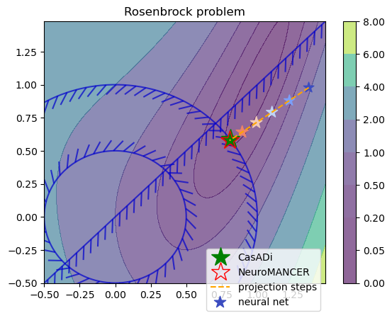
Parametric Constrained Optimization Capabilities in Neuromancer
Training neural networks as explicit solutions
Feasibility restoration with implicit layers

Slide 9
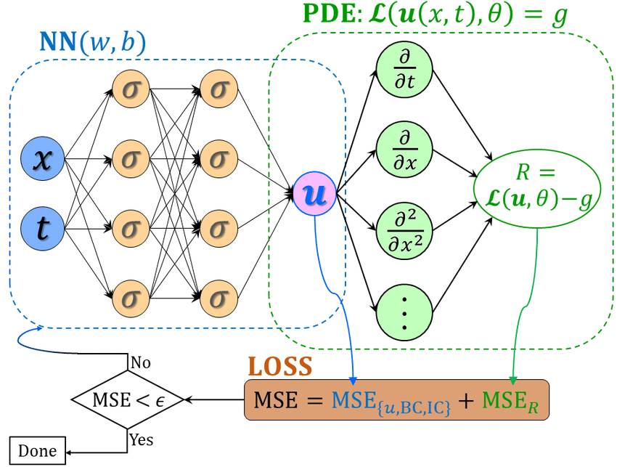
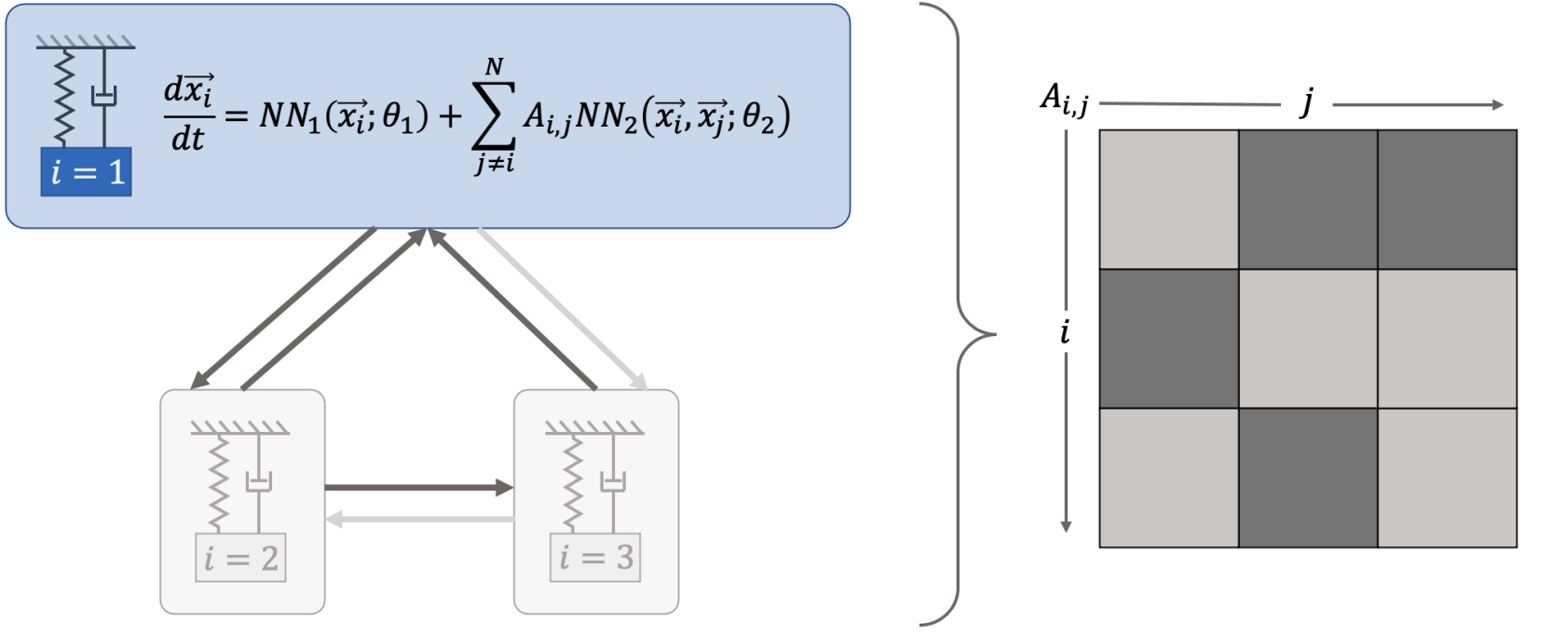
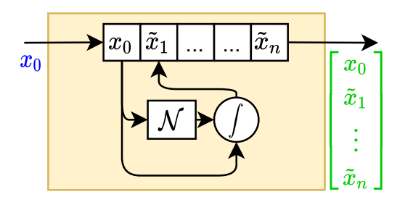
Data-driven Modeling Capabilities in Neuromancer
Component-based Physics-informed Machine Learning
Physics-Informed Neural Networks
Networked Dynamical systems
Neural differential equations

Slide 10
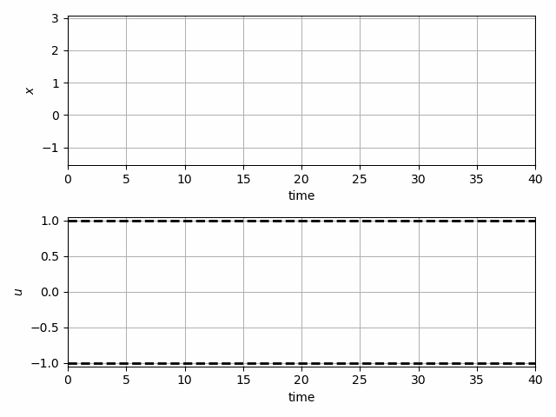
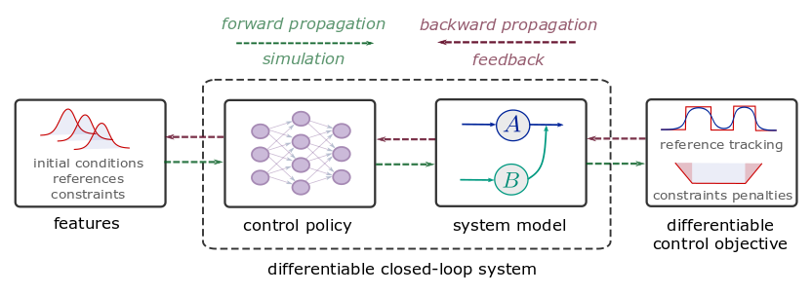
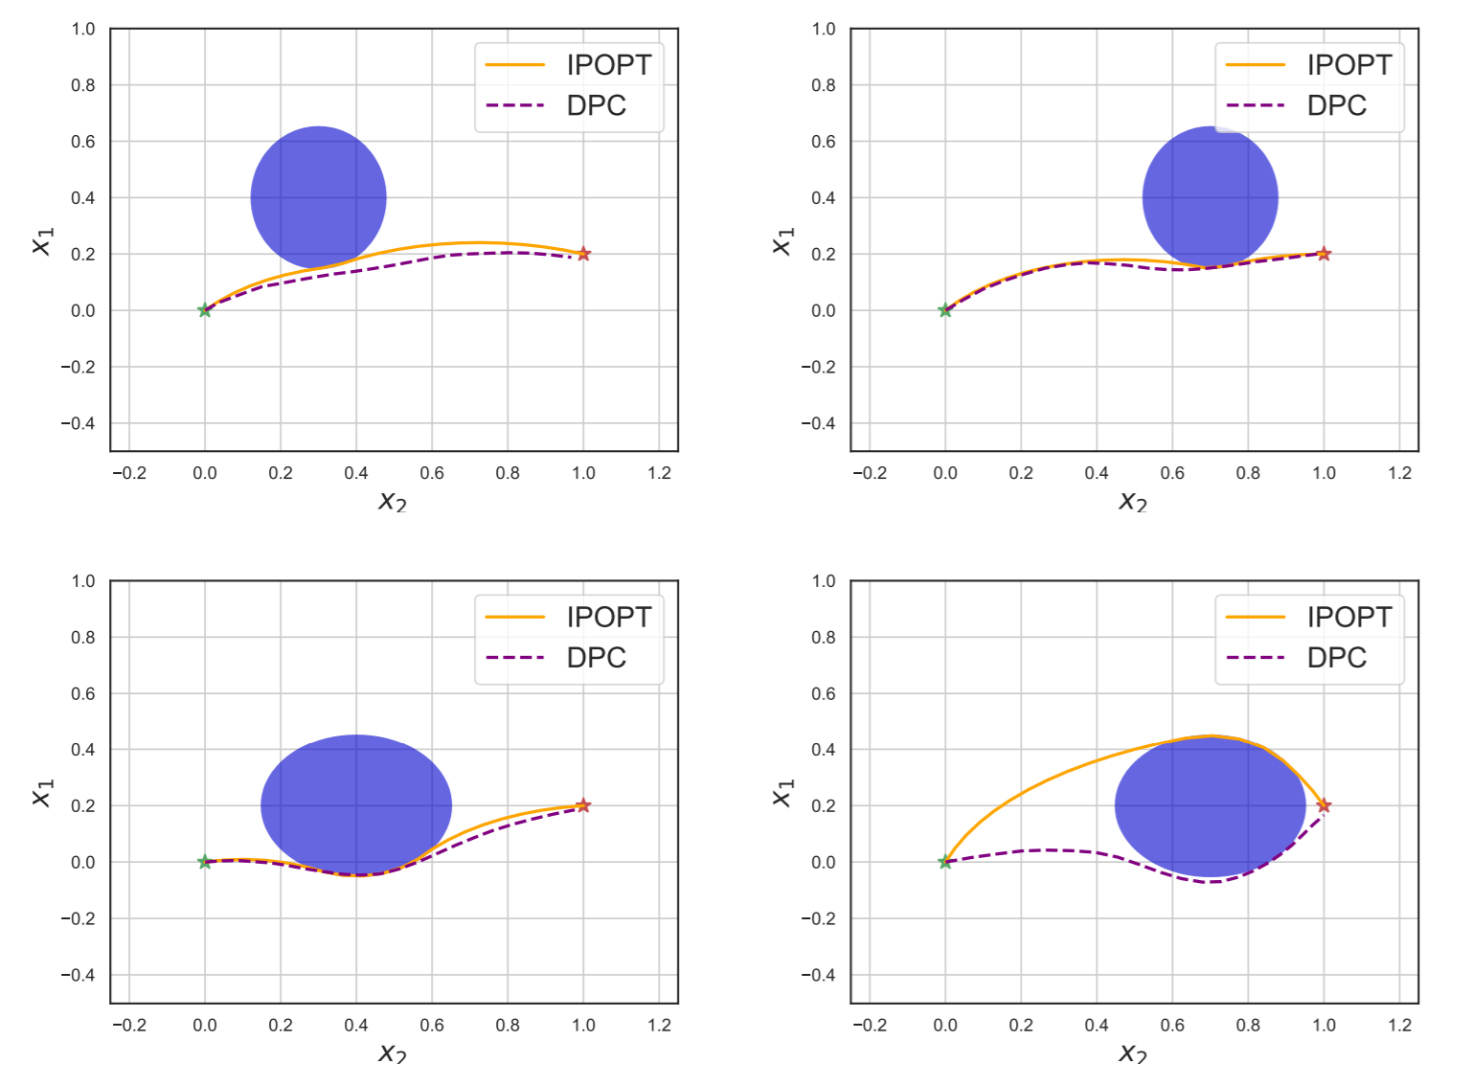
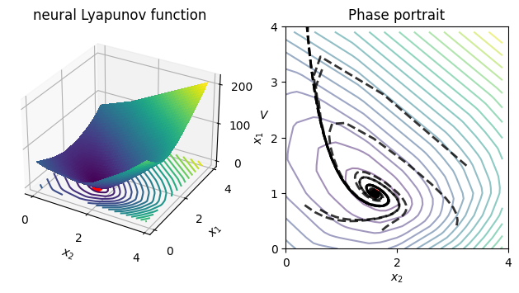
Optimal Control Capabilities in Neuromancer
Learning constrained model-based control policies with differentiable control methods
Learning stabilizing controllers
Trajectory optimization and obstacle avoidance
Learning Neural Lyapunov Functions

Slide 11



NeuroMANCER
Open-source scientific machine learning (SciML) toolbox in PyTorch for integrating deep learning, constrained optimization, and physics-based modeling
Physics-informed machine learning
Data-driven modeling of dynamical systems
Model-based policy optimization
Parametric constrained optimization
github.com/pnnl/neuromancer

Slide 12




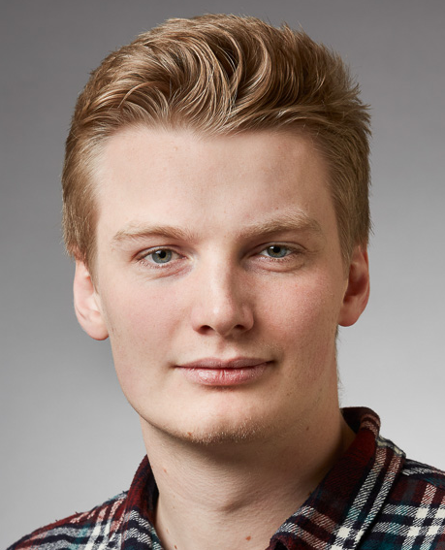





Acknowledgements
Aaron Tuor
James Koch
Madelyn Shapiro
Stefan Dernbach
Christian M. Legaard
Wenceslao Shaw Cortez
Ethan King
Shrirang Abhyankar
Mahantesh Halappanavar
Draguna Vrabie

